Slide 1

DAWOOD UNIVERSITY OF
ENGINEERING & TECHNOLOGY
Pakistan Studies Presentation
Subject: Pakistan Studies
Teacher: Faisal Charan
Section: A2 | BS Cyber Security
Lucknow Pact
Prepared by:
Asiya Shoaib (25F-CY-072)
Syeada Fatima Numrah (25F-CY-056)
Amna Muskan (25F-CY-109)
1916
Page No 1
Pakistan Studies | DUET | 2026

Slide 2

Index
1. Introduction
2. Background of INC & AIML
3. Key Leaders — Role, Methods & Reasons
4. Need for the Lucknow Pact
5. Place, Year & Parties Involved
6. Terms Accepted by Congress (INC)
7. Terms Accepted by Muslim League (AIML)
8. Speeches & Reactions
9. Importance of the Pact
10. Impact & Results
11. Weaknesses of the Pact
12. End of Hindu–Muslim Unity
13. Quaid-e-Azam & Other Movements
14. Conclusion
Page No 2
Lucknow Pact 1916 | Pakistan Studies | DUET – BS Cyber Security

Slide 3
Introduction
The Lucknow Pact of 1916 was a historic political agreement between the Indian National Congress (INC) and the All-India Muslim League (AIML).
It was the first time both major parties of British India came together on a common platform to demand constitutional reforms.
The Pact formally recognised Muslims as a distinct political community with constitutional rights and guaranteed representation.
It is remembered as a powerful symbol of Hindu–Muslim unity during the Indian freedom struggle.
Though it did not last, it shaped future constitutional politics — and ultimately the path to Pakistan.
Page No 3
Lucknow Pact 1916 | Pakistan Studies | DUET – BS Cyber Security

Slide 4
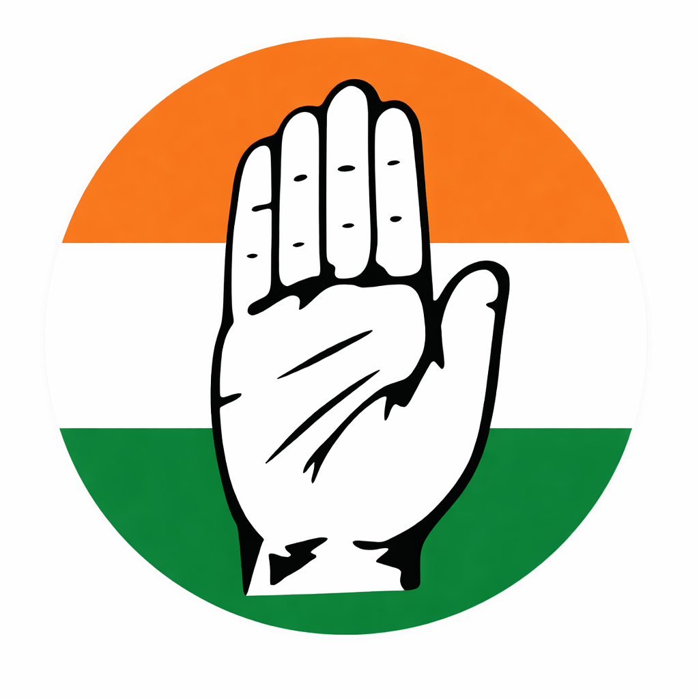
Background of the Indian National Congress (INC)
Founded in 1885 by A.O. Hume, Dadabhai Naoroji, and Dinshaw Wacha — originally a platform for educated Indians to raise political grievances.
Mainly represented Hindu upper-class and educated elites; in the eyes of Muslims, it was a Hindu party.
Split into Moderates (Gokhale) and Extremists (Tilak) by 1907 — later reunited at Lucknow in 1916.
Partition of Bengal (1905) and its annulment (1911) shaped Congress politics deeply.
By 1916, Congress was India’s largest party but needed Muslim support to present a truly all-India front.
British policy of ‘Divide and Rule’ made Congress realise unity with the Muslim League was essential.
Page No 4
Lucknow Pact 1916 | Pakistan Studies | DUET – BS Cyber Security

Slide 5

Background of the All India Muslim League (AIML)
Founded on 30 December 1906 at Dhaka — created after the Simla Deputation in which Muslims asked the Viceroy for separate political representation.
Key early leaders: Aga Khan III (first president), Nawab Salimullah, Nawab Mohsin-ul-Mulk.
Main aim: protect Muslim political, religious, and economic interests under British colonial rule.
Annulment of Partition of Bengal (1911) shook Muslim confidence in Britain’s promises.
By 1913, the League adopted self-government as a goal — bringing it closer to Congress aims.
Jinnah joined the Muslim League in 1913 while still a member of Congress — a critical turning point.
Page No 5
Lucknow Pact 1916 | Pakistan Studies | DUET – BS Cyber Security

Slide 6
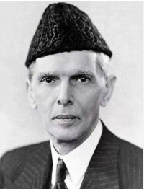
Key Leaders — Role, Methods & Reasons
Muhammad Ali Jinnah — Chief architect; member of both INC & AIML. Called ‘Ambassador of Hindu-Muslim Unity’ by Sarojini Naidu.
Bal Gangadhar Tilak (INC) — Radical nationalist who pushed Congress to accept Muslim demands.
Annie Besant (INC) — Supported the Home Rule movement and backed the united constitutional demand.
Motilal Nehru (INC) — Senior Congress leader who actively backed the negotiations.
Maulana Mohammad Ali & Maulana Shaukat Ali — Urged Muslim political unity and cooperation with Congress.
Strategy: Both parties presented one joint memorandum to the British — far harder to ignore than separate appeals.
Page No 6
Lucknow Pact 1916 | Pakistan Studies | DUET – BS Cyber Security

Slide 7
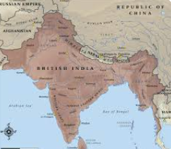
Need for the Lucknow Pact
Indians wanted self-government — but divided demands gave Britain an excuse to delay reforms indefinitely.
Congress needed Muslim support to appear as a truly all-India national party representing all communities.
Muslim League wanted constitutional safeguards to formally protect Muslim minority rights.
World War I (1914–1918) weakened Britain — both parties saw this as the best opportunity to demand reforms.
Joint demands would put far stronger pressure on the British government than separate requests.
Fear of ‘Divide and Rule’: if separated, Britain would use community differences to deny both sides’ demands.
Page No 7
Lucknow Pact 1916 | Pakistan Studies | DUET – BS Cyber Security

Slide 8
Place, Year & Parties Involved
📍 Place & Year
Parties Involved
Place: Lucknow
Year: December 1916
Both Congress and the Muslim League held their annual sessions simultaneously in Lucknow — the Pact was finalised and signed here.
Indian National Congress (INC)
All-India Muslim League (AIML)
This was the FIRST ever major formal political agreement between the two parties — a landmark in the history of the Indian subcontinent.
Page No 8
Lucknow Pact 1916 | Pakistan Studies | DUET – BS Cyber Security

Slide 9
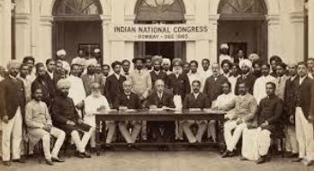
Terms Accepted by the Congress (INC)
Agreed to separate electorates — Muslims would vote in their own lists and elect their own representatives.
Accepted that one-third (1/3) of Central Legislative Council seats be reserved for Muslims.
Formally recognised Muslims as a distinct political community with their own constitutional identity.
Agreed to provincial weightage for Muslims in provinces where they were a minority.
Accepted veto clause — no bill affecting one community could pass if 3/4 of that community’s reps opposed it.
Dropped earlier opposition to reserved seats — a major concession by Hindu leaders.
Tilak personally approved the terms, calling Muslim demands ‘just and reasonable.’
Page No 9
Lucknow Pact 1916 | Pakistan Studies | DUET – BS Cyber Security

Slide 10
Terms Accepted by the Muslim League (AIML)
Accepted reduced seats in Muslim-majority provinces as a sacrifice for the sake of unity.
Punjab: Accepted 50% seats despite Muslims being 55%+ of the population.
Bengal: Accepted 40% seats despite Muslims being the majority — to balance Hindu concerns.
Agreed to jointly demand self-government and constitutional reforms alongside Congress.
Accepted that Hindus would receive extra representation in Muslim-majority provinces.
Agreed to present one united Congress-League constitutional scheme to the British government.
Recognised that political unity was more valuable than strict proportional representation.
Page No 10
Lucknow Pact 1916 | Pakistan Studies | DUET – BS Cyber Security

Slide 11
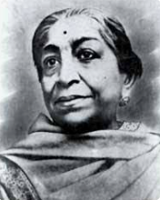
Speeches, Statements & Reactions
M.A. Jinnah (Dec 1916): Called the Pact ‘a great step toward national unity and self-government.’
Sarojini Naidu: Praised Jinnah as ‘the Ambassador of Hindu-Muslim Unity’ — a title that defined his era.
Bal Gangadhar Tilak: Publicly supported all terms, calling Muslim demands ‘just and reasonable.’
Maulana Mohammad Ali: Expressed hope that this marks the beginning of a truly unified India.
British officials: Alarmed — a united Indian demand was far harder to resist or divide.
Indian public: Celebrated as a sign that independence and self-rule were within reach.
Page No 11
Lucknow Pact 1916 | Pakistan Studies | DUET – BS Cyber Security

Slide 12
Importance of the Lucknow Pact
First ever formal agreement between INC and AIML — a historic landmark in Indian politics.
Strengthened the freedom movement by creating the first truly united all-India political front.
Promoted Hindu-Muslim unity on a formal, constitutional basis for the first time.
Increased Muslim confidence in Congress — felt their rights and identity would be respected.
Created a united front that put real, effective pressure on the British government.
Led directly to the Montagu–Chelmsford Reforms (1919) — a partial but significant British response.
Set a precedent for communal representation in all future Indian constitutional arrangements.
Page No 12
Lucknow Pact 1916 | Pakistan Studies | DUET – BS Cyber Security

Slide 13
Impact & Results
British government formally recognised Indian political unity for the very first time.
Led to the Montagu–Chelmsford Reforms (1919) — limited self-governance granted to Indians.
Muslim League emerged as a strong, nationally recognised political force.
Established Muhammad Ali Jinnah as India’s most important political leader and bridge-builder.
Increased Indian self-confidence in demanding rights through peaceful, constitutional means.
Boosted the overall independence movement — Indians saw that united pressure worked.
Page No 13
Lucknow Pact 1916 | Pakistan Studies | DUET – BS Cyber Security

Slide 14
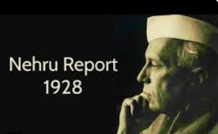
Weaknesses of the Pact & End of Hindu–Muslim Unity
Unity was temporary — built on political convenience, not deep community-level trust.
Separate electorates, while protecting Muslims short-term, deepened communal identities over time.
No enforcement mechanism — the agreement depended entirely on the goodwill of both parties.
Failure of the Khilafat Movement (1919–1924): Its collapse destroyed the goodwill built by the Pact.
Rise of communal politics — religion increasingly dominated political identity on both sides.
Nehru Report (1928): Congress rejected separate electorates — directly betrayed the spirit of the Pact.
Jinnah’s 14 Points (1929): Final breakdown of Congress-League unity.
Page No 14
Lucknow Pact 1916 | Pakistan Studies | DUET – BS Cyber Security

Slide 15
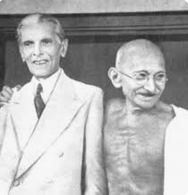
Quaid-e-Azam & Other Movements
Jinnah’s departure from Congress (1920): Disagreed with Gandhi’s mass civil disobedience approach.
Khilafat Movement (1919–24): Temporarily extended Hindu-Muslim unity but introduced religion into mass politics.
Non-Cooperation Movement (1920–22): Brought masses in but alienated Muslim League’s educated leaders.
Hindu Mahasabha & Shuddhi Movement: Hindu revivalism alarmed Muslims and deepened the communal divide.
Failure of Round Table Conferences (1930–32): Congress and AIML failed to revive cooperation.
Key lesson: The Pact’s collapse convinced Jinnah that Muslims needed a separate homeland — the seed for Pakistan Movement.
Page No 15
Lucknow Pact 1916 | Pakistan Studies | DUET – BS Cyber Security

Slide 16
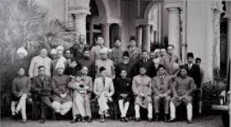
Conclusion
The Lucknow Pact of 1916 was a milestone in the Indian freedom struggle.
It proved that Hindus and Muslims could work together for a common cause — and used that unity to win the Montagu–Chelmsford Reforms (1919).
Although the unity did not last long, the Pact played a vital role in shaping future constitutional developments in both India and Pakistan.
Its collapse convinced Quaid-e-Azam Jinnah that constitutional guarantees alone were not enough — a realisation that ultimately led to the demand for Pakistan in 1940 and independence in 1947.
Page No 16
Lucknow Pact 1916 | Pakistan Studies | DUET – BS Cyber Security

